Slide 1
Company Bankruptcy Prediction
Group 59
Jiangying Zhong
Jingxuan Li
4/25/2022

Slide 2
Contents
Contents
Project Overview Project Proposal
Exploratory Data Analysis(EDA)
Feature Extraction
Model Building
Performance Evaluation
Prediction Result & Best Model
Challeges Faced
3
4
5
10
11
12
21
22

Slide 3


Project Overview
Under condition of market economy, the bankruptcy and establishment of enterprises exist objectively. So accurately judging whether the enterprise is facing bankruptcy will be able to minimize their financial risks and obtain better economic benefits.
The main goal of this project is to use several machine learning techniques to identify whether the company with different accounting indicators has bankrupted. (classification problem)

Slide 4
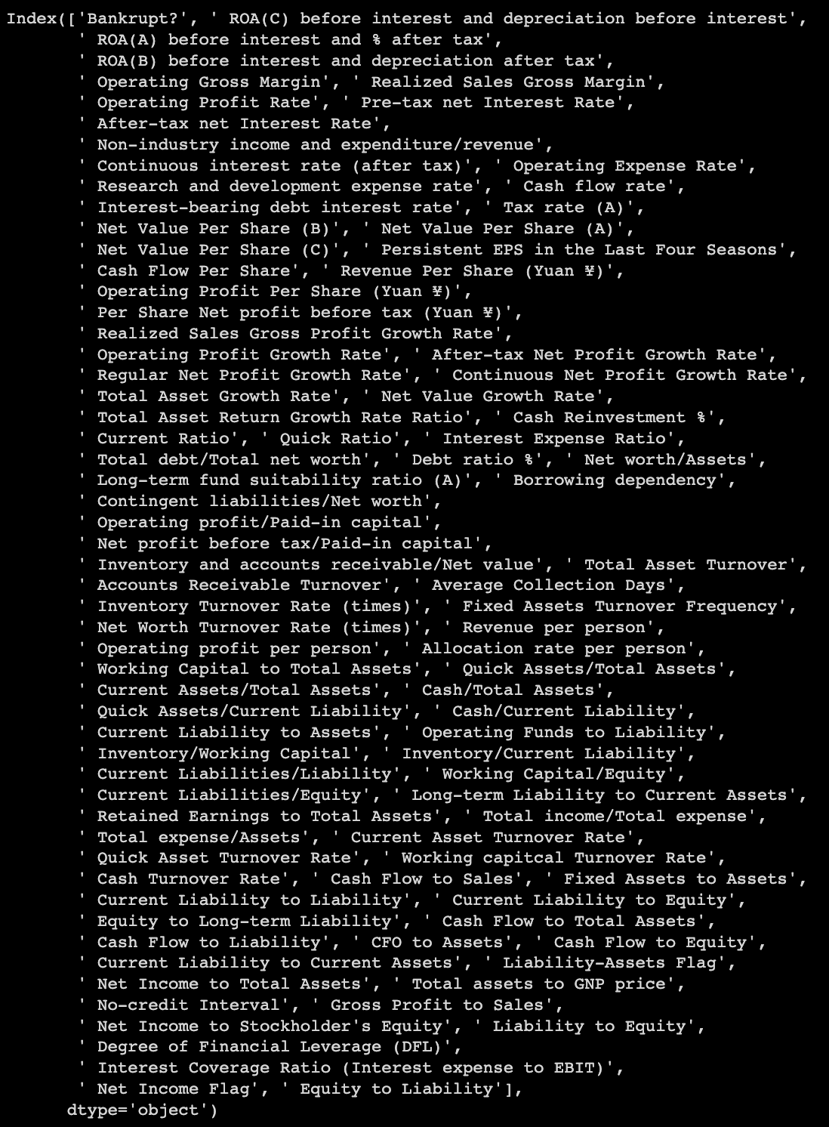
Project Proposal
Data Setting & Data Definition
Classify the features that lead to Bankruptcy for companies.
Figure out the correlations across categories provided.
Apply SMOTE to deal with the data imbalance.
Implement several machine learning methods to create models and then evaluate to find the best model.
Data Description & Data Source
The dataset contains 6819 rows and 96 columns, 95 of them are the predictors while 'Bankrupt?' column is our responsible variabe.
Out of all the predictor columns, 93 are decimals, 2 are integers and one is boolean.
Data Source

Slide 5
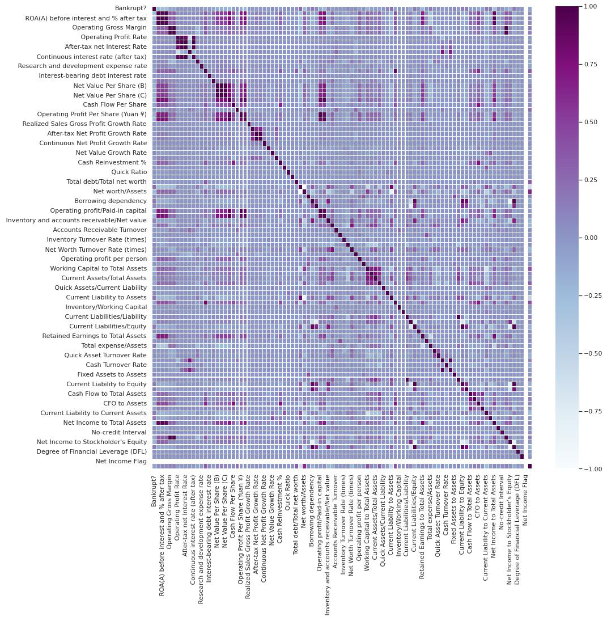
Exploratory Data Analysis
Correlation/ Heatmap
The correlation between Operating Gross Margin and Realized Sales Gross Margin is the highest, reaching 0.999518.
The correlation between Operating Profit Per Share (Yuan ¥) and Operating profit/Paid-in capital is the second, reaching 0.998696.

Slide 6
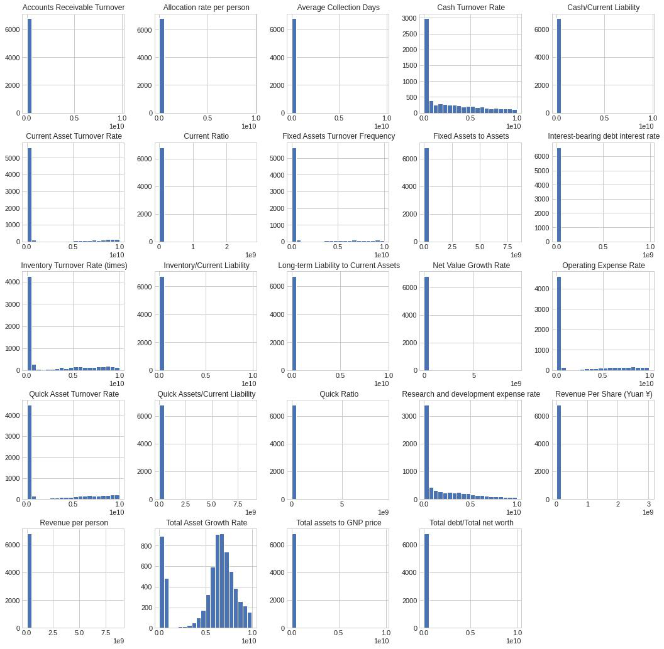
Exploratory Data Analysis
Non-Fractional Histgrams
fractional columns: the columns that contain the values between 0 and 1
non-fractional columns: columns that contain different values
Hence, we should focus on non-fractional columns because they have different values, the probability of having outliers is high.

Slide 7
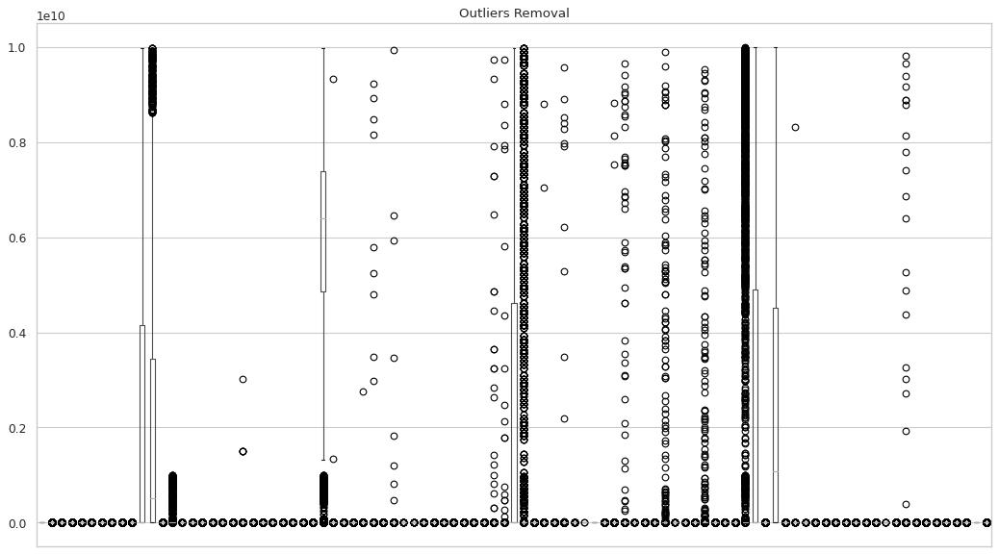
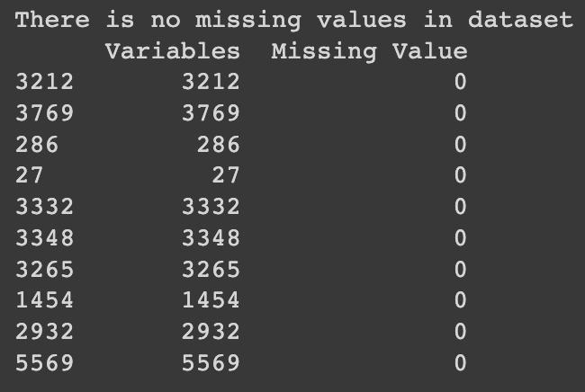
Exploratory Data Analysis
Missing Value & Outlier Removal
The data is clean and there are no missing values.
Processing rules to remove outliers:
outliers larger than 75% percentile are replaced with upper quartile values;
outliers smaller than 25% percentile are replaced with lower quartile values.

Slide 8
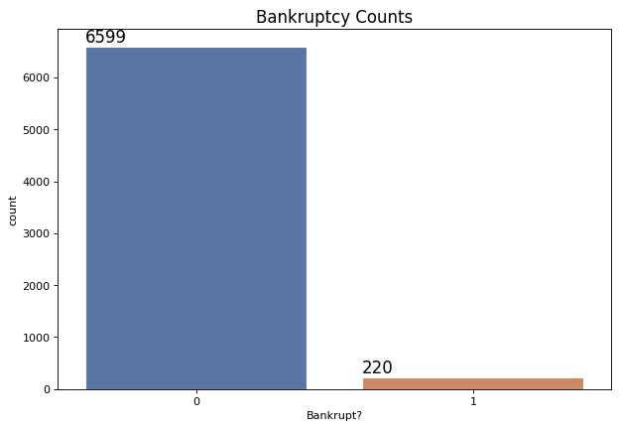
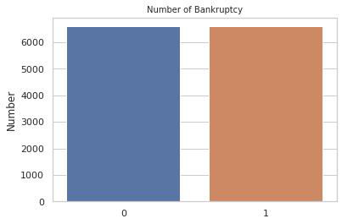
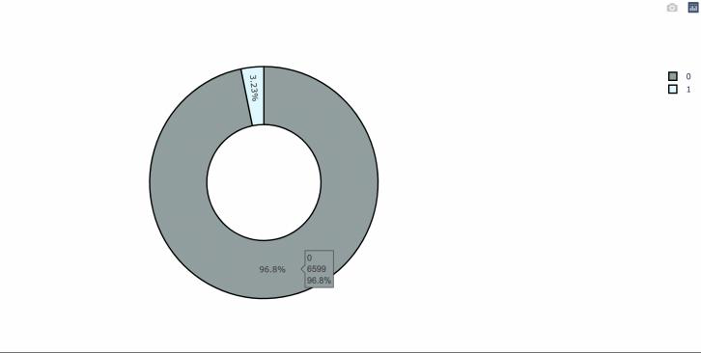
Exploratory Data Analysis
Data Imbalance
SMOTE
Imbalanced Data
Balanced Data

Slide 9
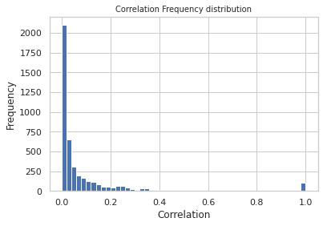
Exploratory Data Analysis
Correlation Frequency Distribution
Since most features are uncorrelated with each other but there are also some of them correlated. Hence, we need to reduce dimension.
PCA
Feature Extraction

Slide 10
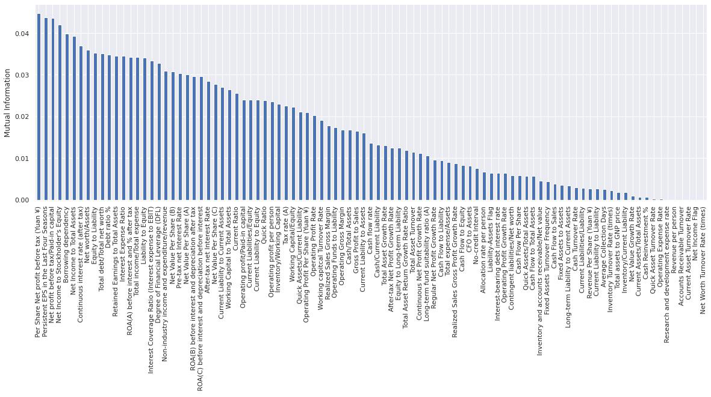
Feature Extraction
Feature Extraction
Left are features with higher mutual information values.
Right are features with almost zero mutual information values
we selected top 10 features.

Slide 11
Model Building
Data Mining Model
We split the data set into a 75% training set and a 25% test set.
The following models were used
Logistic Regression Model
KNN Model
Decision Tree Model
Random Forest Model
SVM Model
XGBoost Model
Naive Bayes Model

Slide 12
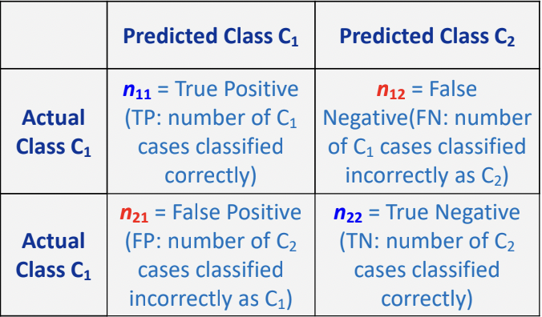
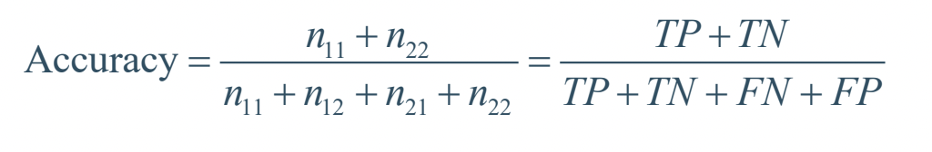
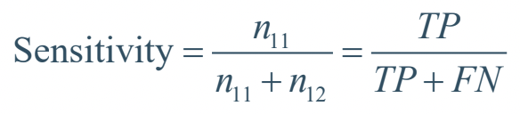
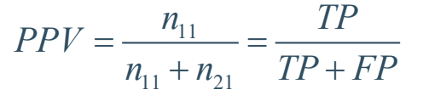
Performance Evaluation
Performance Evaluation Factors
Confusion Matrix:
Statistical Factor:
accuracy
precision(PPV)
recall(Sensitivity)
F1-score
Curve:
ROC Curve
Precision-Recall Curve

Slide 13
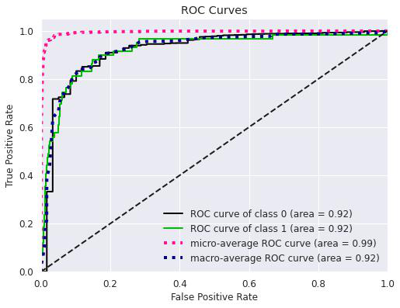
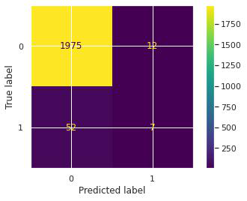
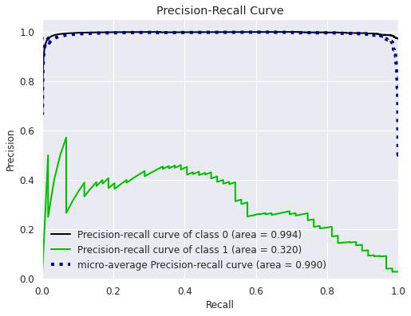
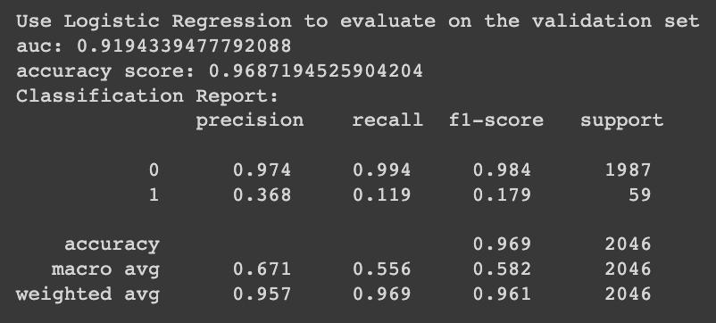
Performance Evaluation
Logistic Regression Model
Notes:
True Positive

Slide 14
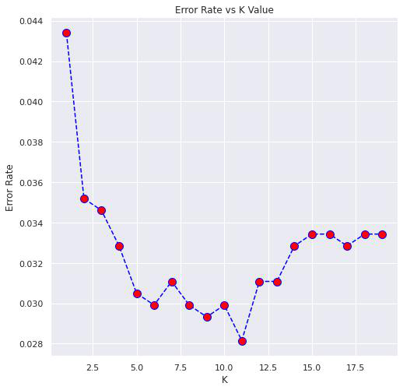
Performance Evaluation
KNN Model
In KNN model, we calculated the model error depending on K from 1 to 20 and then chose the K=11, where the error dropped the lowest and k becomed the best K value.

Slide 15
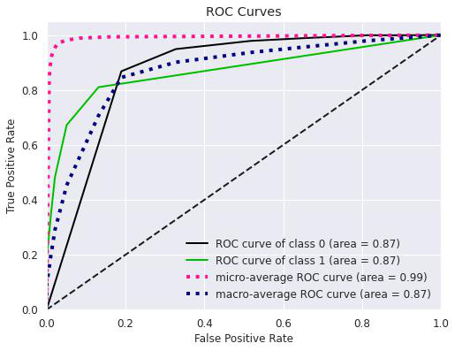
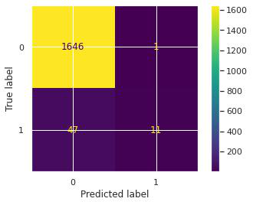
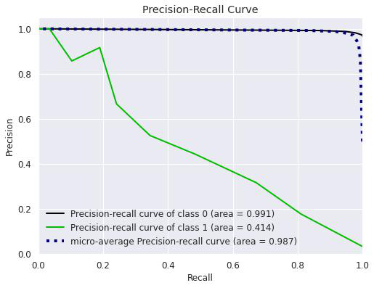
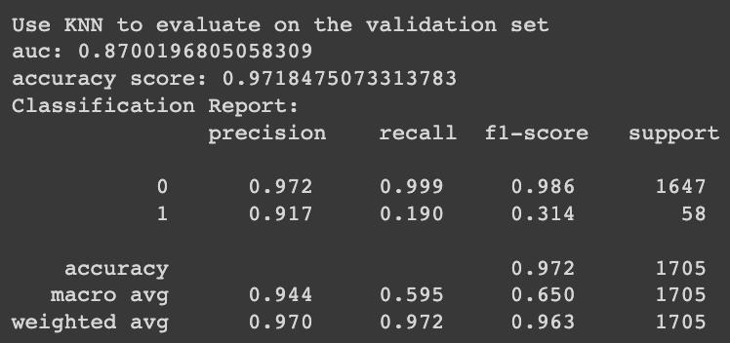
Performance Evaluation
KNN Model

Slide 16
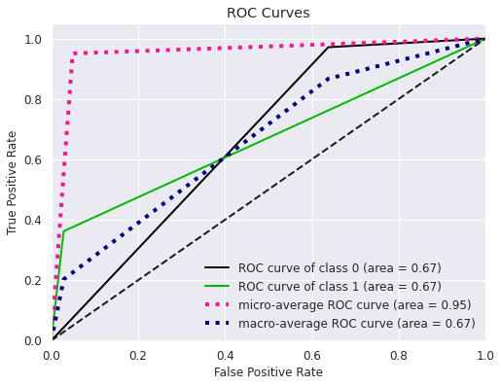
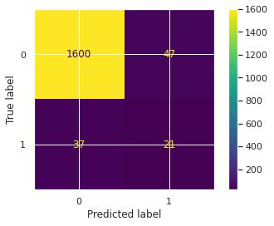
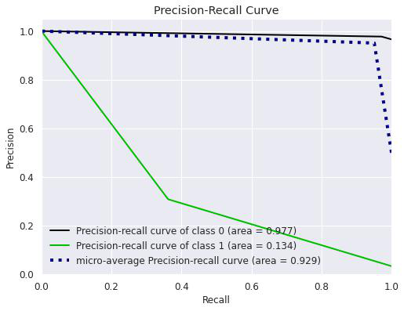
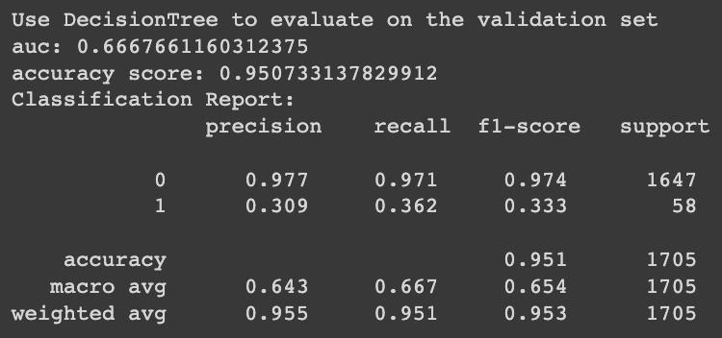
Performance Evaluation
Decision Tree Model

Slide 17
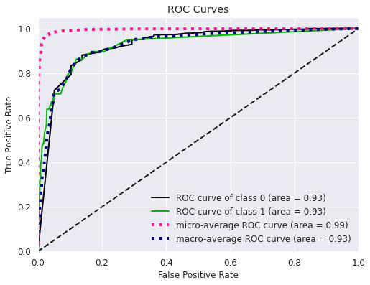

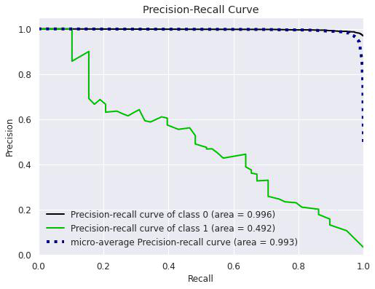
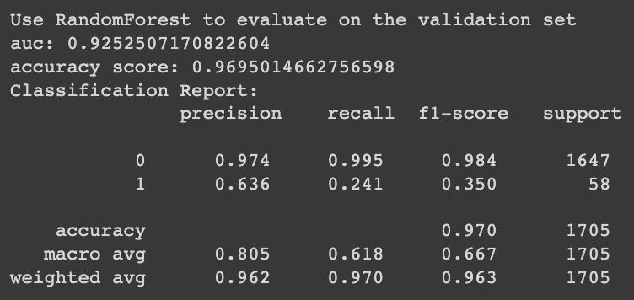
Performance Evaluation
Random Forest Model

Slide 18
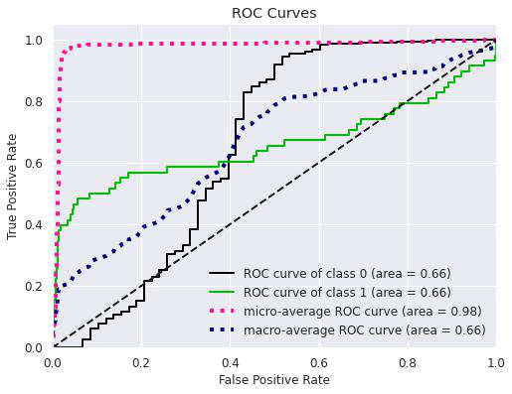

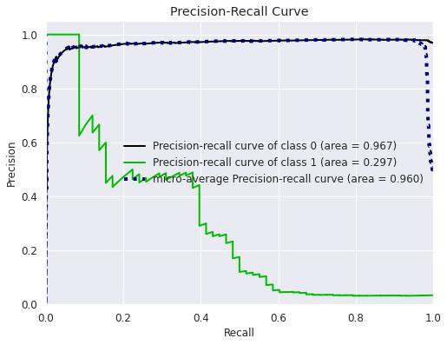
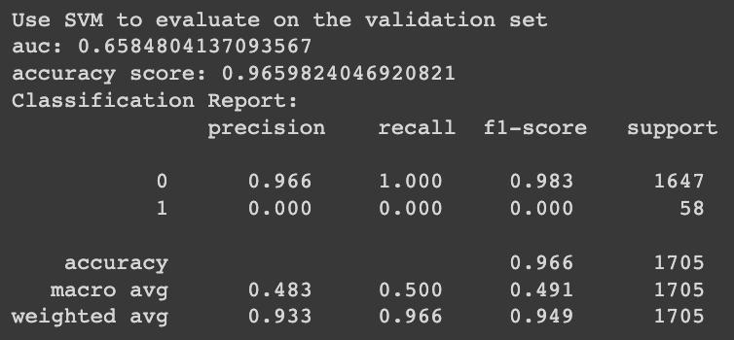
Performance Evaluation
SVM Model

Slide 19
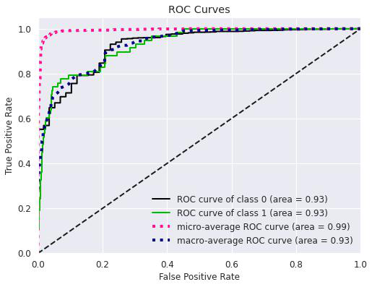

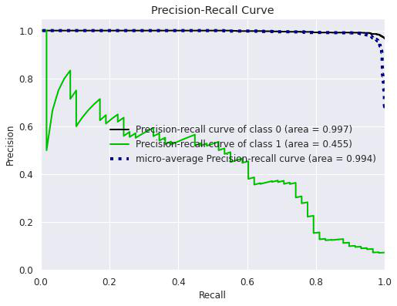
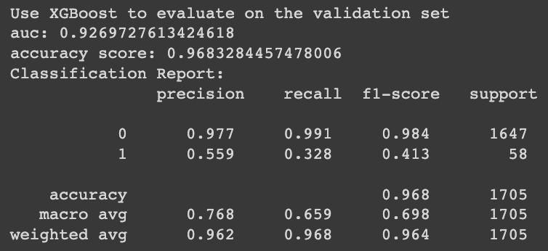
Performance Evaluation
XGBoost Model

Slide 20
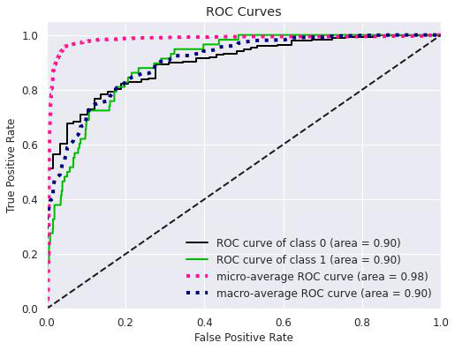
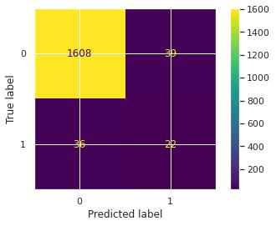
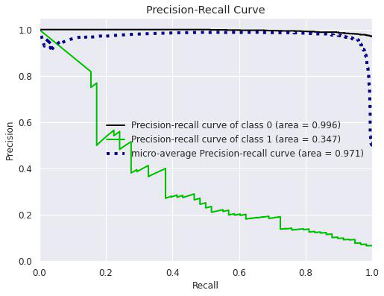
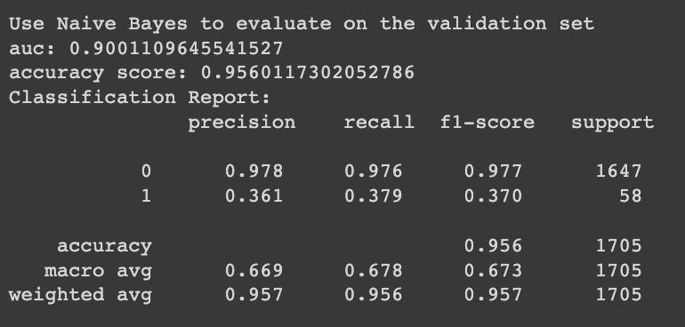
Performance Evaluation
Naive Bayes Model

Slide 21
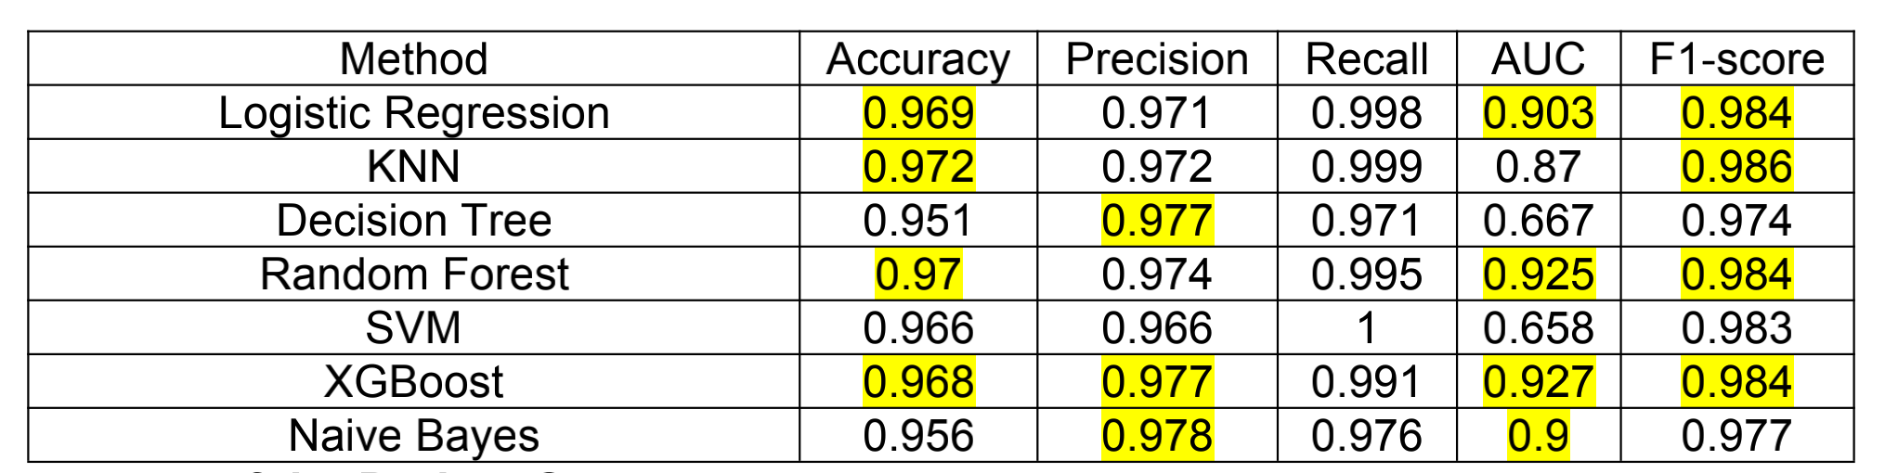
Prediction Result & Best Model
Prediction Result
Best Model
Our final result determined that the best prediction model for our dataset would be the XGBoost Model.

Slide 22


Challenges Faced
Outliers
Challenges
Time Consuming Opt
Due to the complexity of the data, the outliers are quite hard to define and we tried to define non-fractional columns to remove outliers.
High Computation time for optimization of KNN and SVM.
Dimension Reduction
Finding Best Model
PCA effect is not as expected, so we adopted SelectKBest() to achieve the purpose of dimensionality reduction through feature extraction
Due to the quite close evaluation factors, there's a little bit difficult for us to decide the best model that fit our data

